Slide 1

Heart Disease Data
In an Effort to Predict Heart Attack Prediction
DSC530
Mohammed Amine Frakso

Slide 2
Statistical Hypothesis
Can we find any other trends in heart data to predict certain cardiovascular events or find any clear indications of heart health?
What extra features could be included to make a more informed analysis?

Slide 3
Summary of the Dataset
UCI Machine Learning Repository-Heart Disease Dataset
Number of Records: 303
Number of features: 75
Features used: 14
Training: 250 Records
Testing: 53 Records

Slide 4
Description of the Dataset
The dataset used in this project is the Cleveland Heart Disease dataset taken from the UCI repository.
The dataset consists of 303 individuals data. There are 14 columns in the dataset, 5 of them are described below.

Slide 5
What the 14 variables mean in the dataset
Age: displays the age of the individual.
Sex: displays the gender of the individual using the following format : 1 = male 0 = female
Chest-pain type: displays the type of chest-pain experienced by the individual using the following format : 1 = typical angina 2 = atypical angina 3 = non — anginal pain 4 = asymptotic
Resting Blood Pressure: displays the resting blood pressure value of an individual in mmHg (unit)
Serum Cholestrol: displays the serum cholesterol in mg/dl (unit)
Fasting Blood Sugar: compares the fasting blood sugar value of an individual with 120mg/dl. If fasting blood sugar > 120mg/dl then : 1 (true) else : 0 (false)
Resting ECG : displays resting electrocardiographic results 0 = normal 1 = having ST-T wave abnormality 2 = left ventricular hyperthrophy
Max heart rate achieved : displays the max heart rate achieved by an individual.
Exercise induced angina : 1 = yes 0 = no
ST depression induced by exercise relative to rest: displays the value which is an integer or float.
Peak exercise ST segment : 1 = upsloping 2 = flat 3 = downsloping
Number of major vessels (0–3) colored by flourosopy : displays the value as integer or float.
Thal : displays the thalassemia : 3 = normal 6 = fixed defect 7 = reversible defect
Diagnosis of heart disease : Displays whether the individual is suffering from heart disease or not : 0 = absence 1, 2, 3, 4 = present.

Slide 6
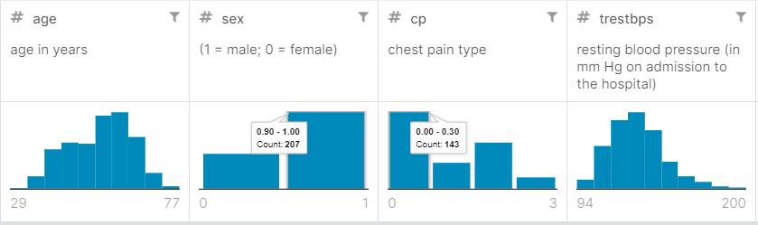
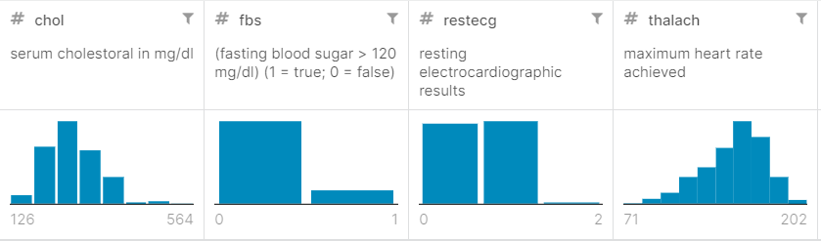
Histogram of each of the 14 variables

Slide 7
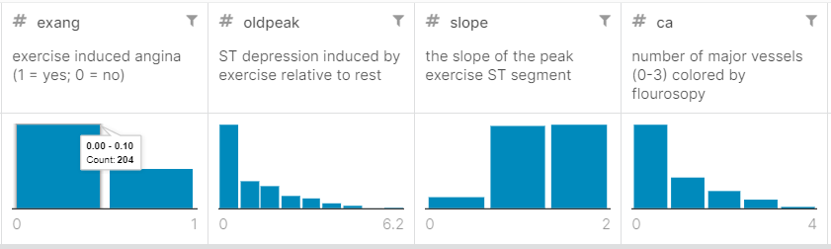
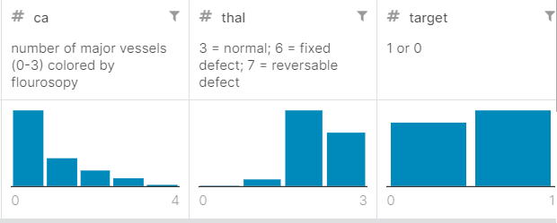
Histogram of each of the 14 variables

Slide 8
Data processing and Outliers
Normalized the data to a standard normal distribution.
Used PCA as a feature extraction technique to select principal components .
Plotted the variance explained by the principal components to select the necessary principal components.
14 out of 75 features were selected to build the models.
Cohorts variable contained a number of individuals possessing very high cholesterol, while there were more higher outliers in the diseased group.
There are some outliers, which are represented in the Cohorts variable that contained a number of individuals possessing very high cholesterol. We will remove any such outliers that might affect the results drastically.

Slide 9
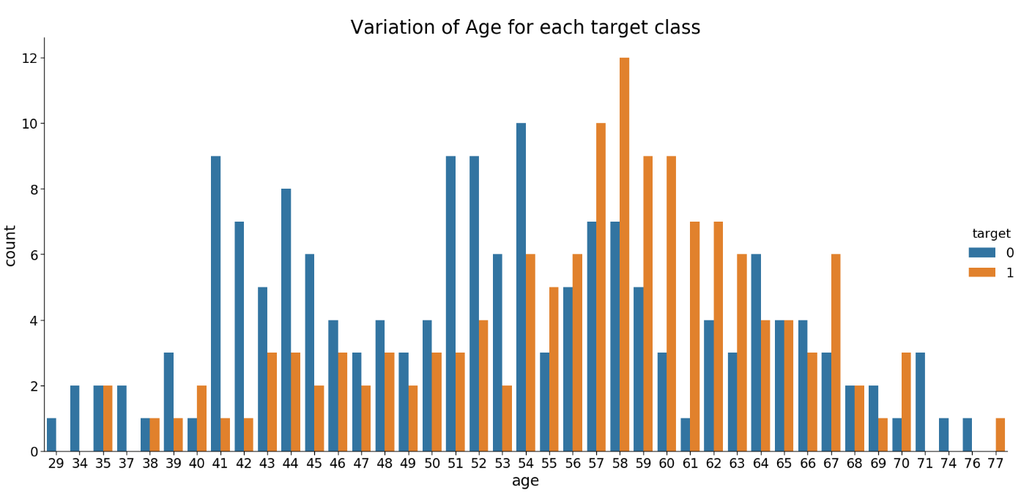
Exploration and Data Analysis
We start analyzing the age. target = 1 implies that the person is suffering from heart disease and target = 0 implies the person is not suffering.
Clearly , people belonging to the age group 54 to 67 are suffering from heart disease.

Slide 10
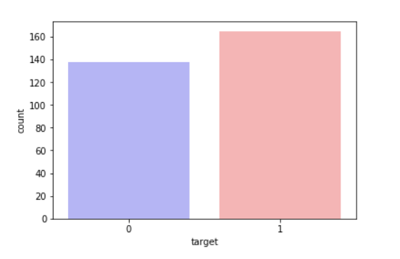
Exploration and Data Analysis
Percentage of Patients Haven't Heart Disease: 45.54%
Percentage of Patients Have Heart Disease: 54.46%

Slide 11
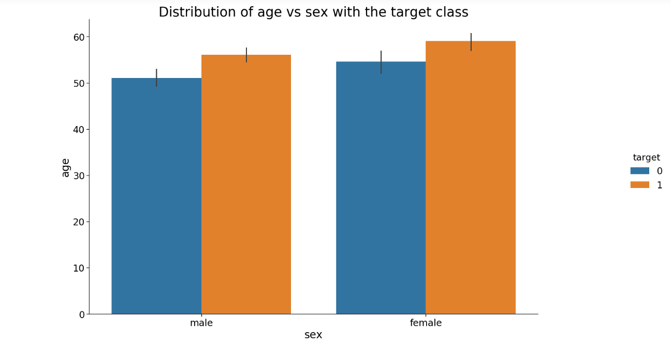
Distribution of age and gender for each target class.
We see that females who are suffering from heart disease are older than males.

Slide 12
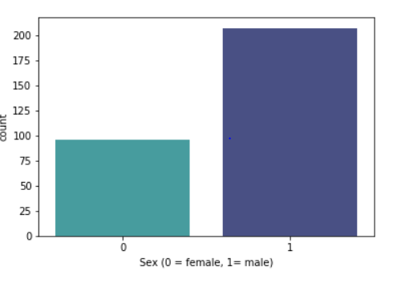
Exploration and Data Analysis
Percentage of Female Patients: 31.68%
Percentage of Male Patients: 68.32%

Slide 13
Summary
It is difficult to manually determine the odds of getting heart disease based on risk factors. However, machine learning techniques are useful to predict the output from existing data.

